Slide 1
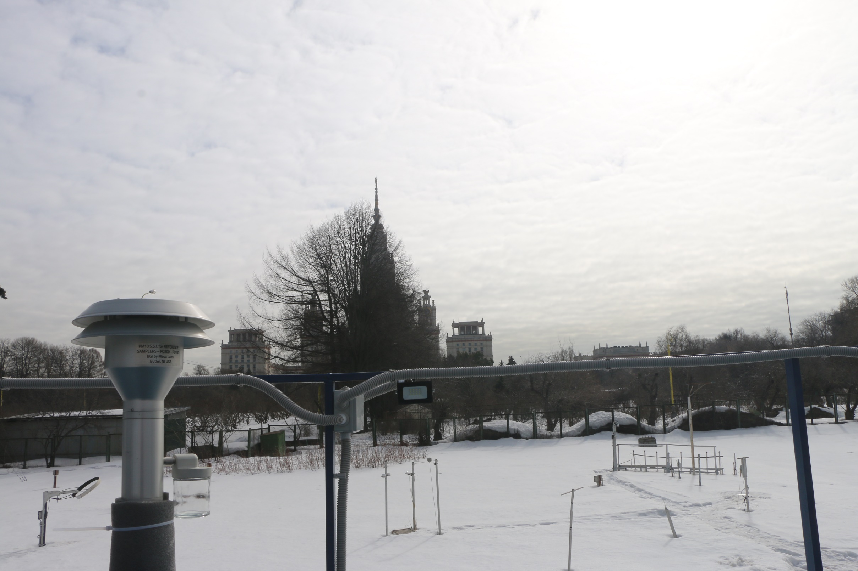
WP2.
Task 2.1 Measurement of physical-chemical properties of urban aerosols
Season and diurnal dynamics of particle mass,
black carbon and size-segregated chemical composition
Planning and main purposes
Olga Popovicheva
Roman Kovach,
Marina Chichaeva, Julia Zavgorodnaya

Slide 2
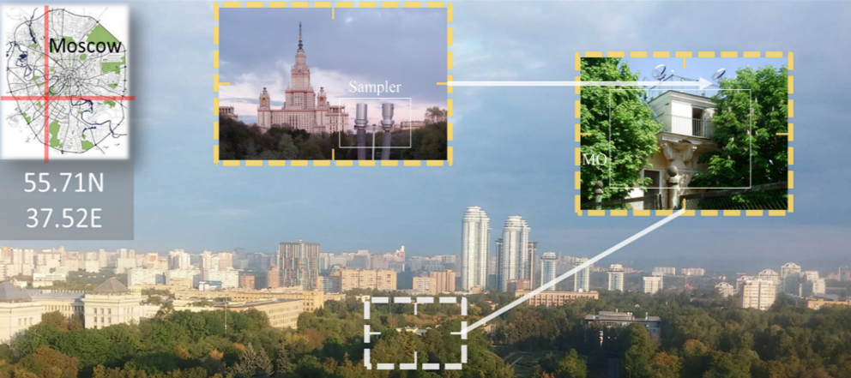
I. Aerosol Infrastructure

Slide 3
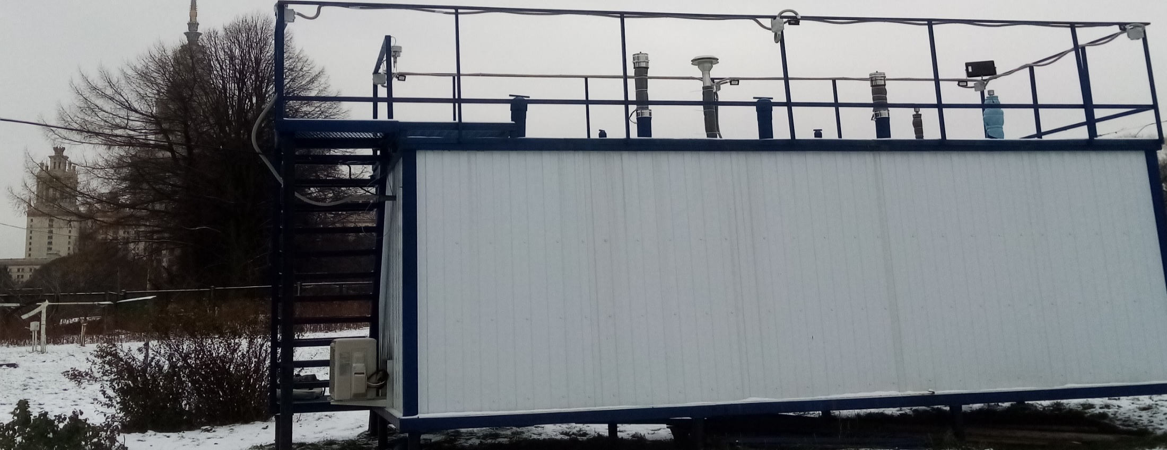
- Developing of Atmospheric division of
Laboratory of Urban Environment with state-of-the-art observational capacity
Atmospheric division
Aerosol Complex MSU
- Long-term comprehensive observations will be performed on Aerosol Instrumentation Complex MSU

Slide 4
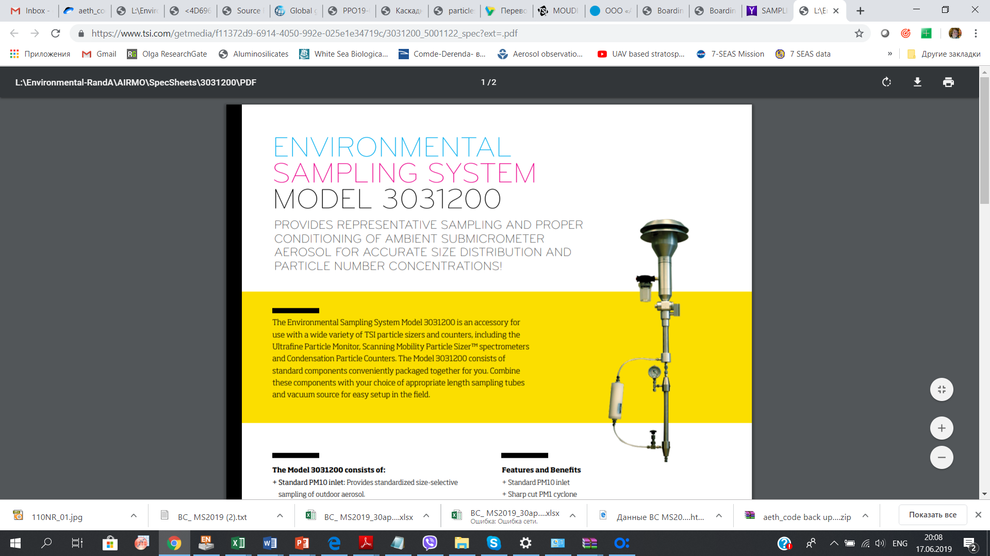
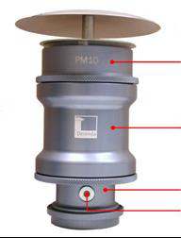
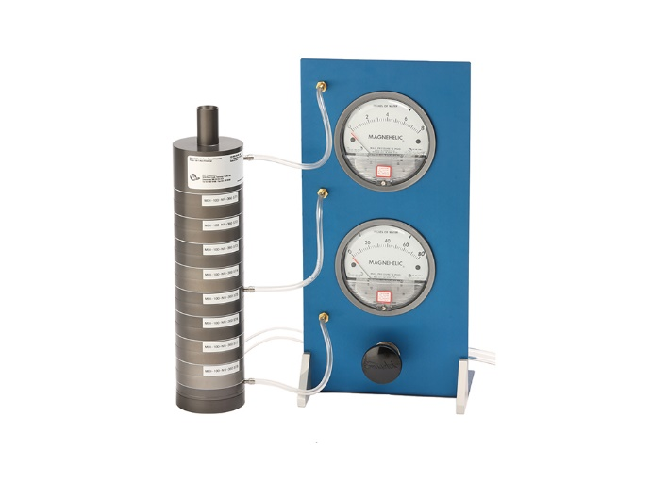
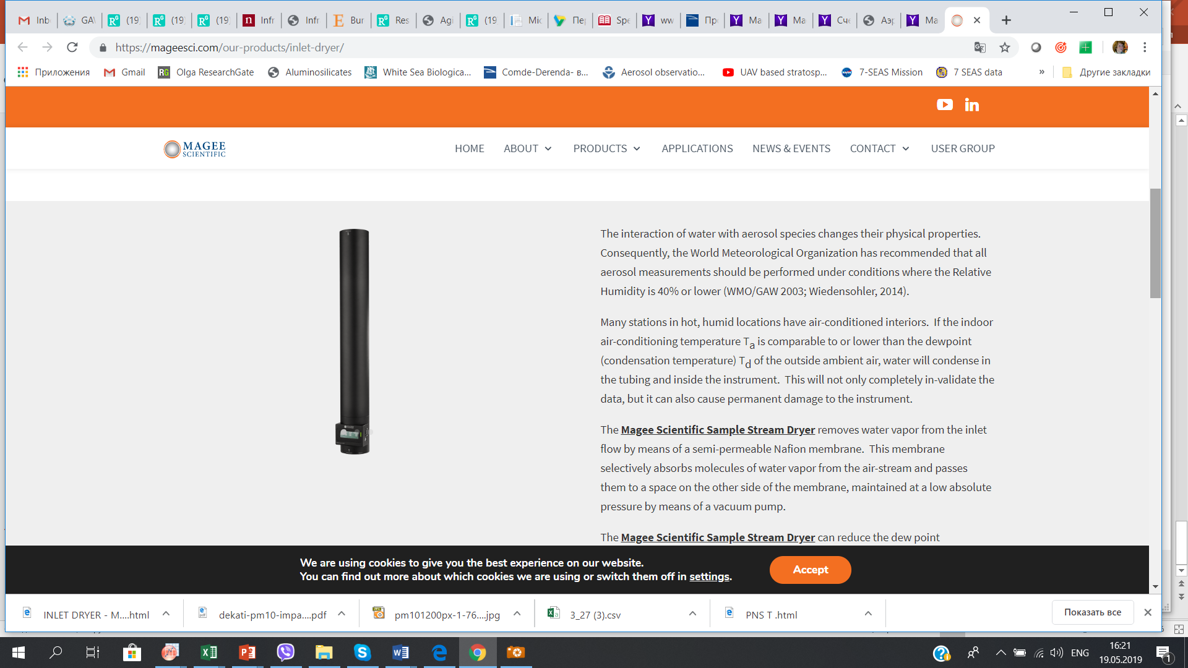
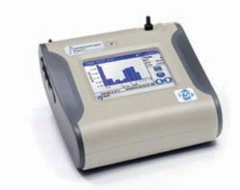
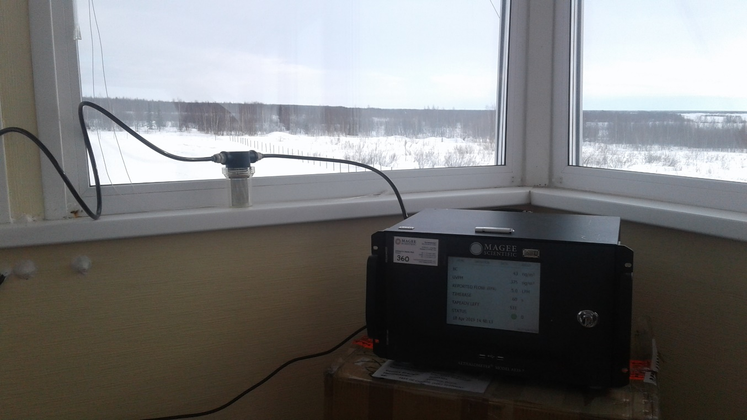
Aerosol Instrumentation Complex MSU- infrastructure
for measurements of optical and physico-chemical properties of ambient aerosols
8 stages
Impactor
180 nm – 10 µm
Automatic
Sampler PNS
LVS
sampler
Optical particle counter
> 300 nm – 10 µm
Aethalometer AE33
Moudi 100NR

Slide 5
II. Research. Aerosol physics and optics.
1. Quantifying the aerosol day-to-night pollution
based on measurements of
А) diurnal variability of BC, PM2.5 and PM10 mass, and particle number size distribution,
2. Identification of sources for particular dynamics of
- stable high BC pollution at night time ,
significant BC variability at day and morning hours
3. Establishing the relation of stable high light-absorbing aerosol pollution at night time to dynamics of boundary layer and to temporal characteristics of urban heat island

Slide 6
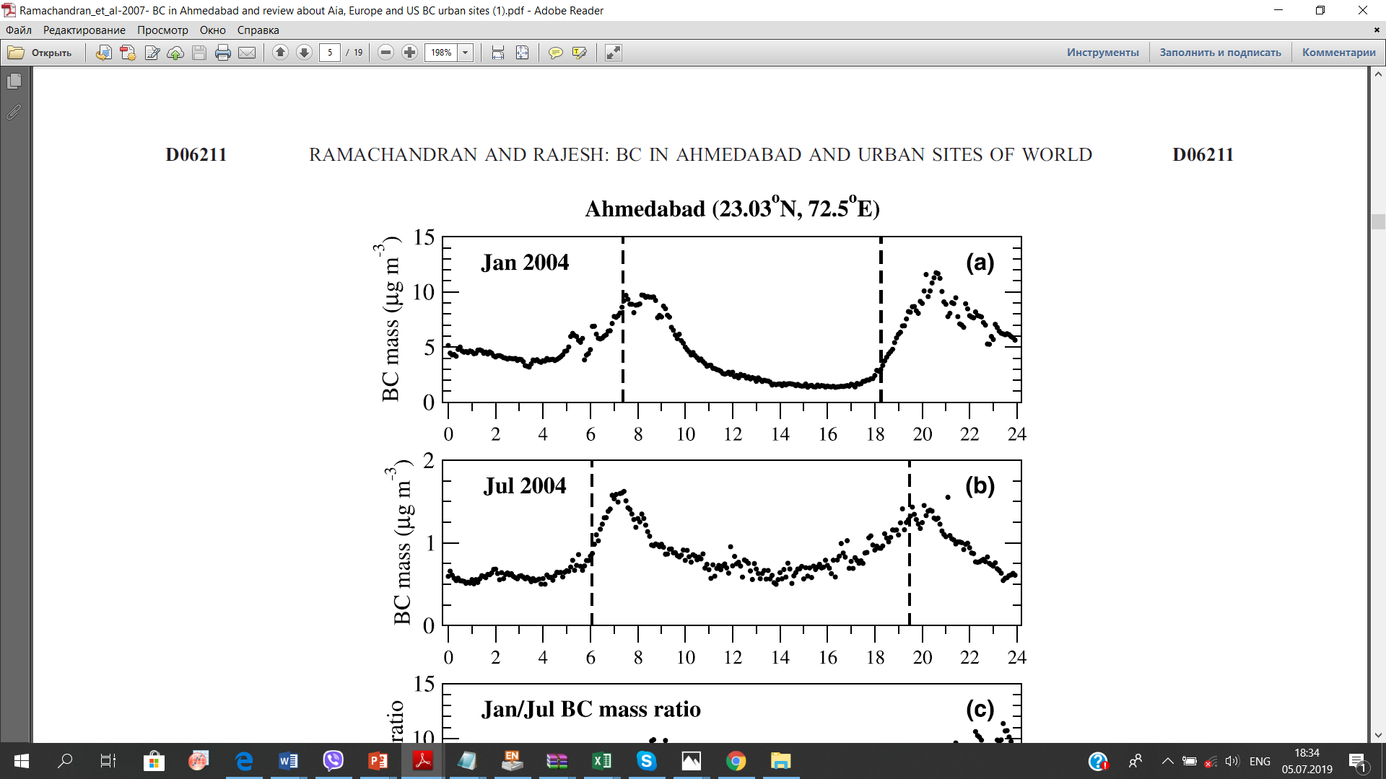
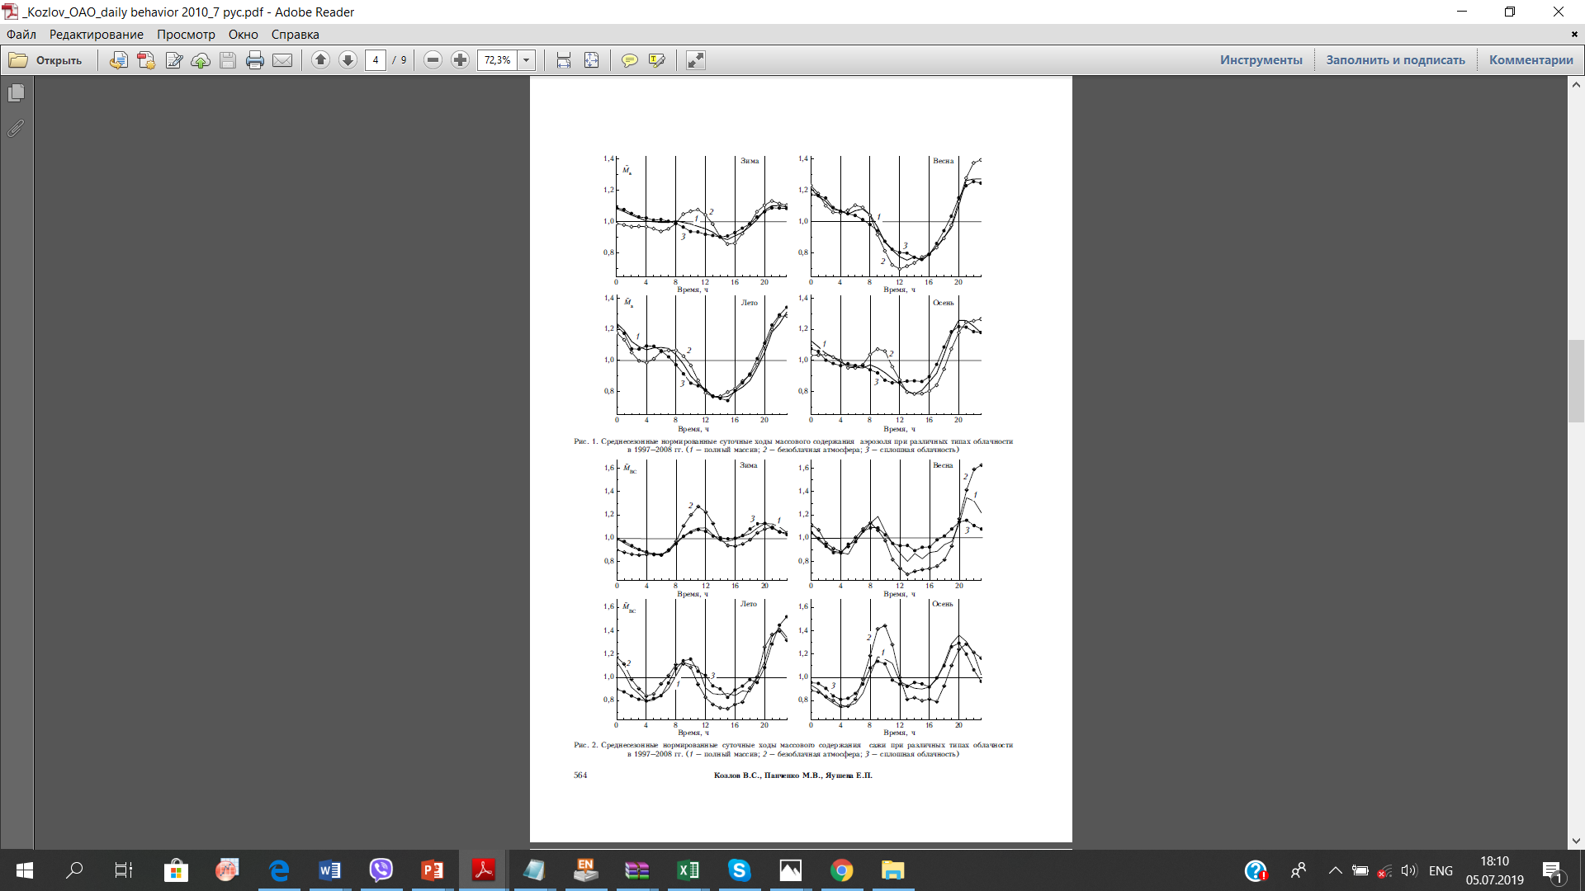
Two peak structure of BC diurnal trend
Typical features of urban diurnal variability :
morning and evening peaks due to BL change and anthropogenic activity
Ramachandran et al, 2007, India
Tomsk, Kozlov et al., 2010
BC, µg/m3
spring
summer
autumn

Slide 7
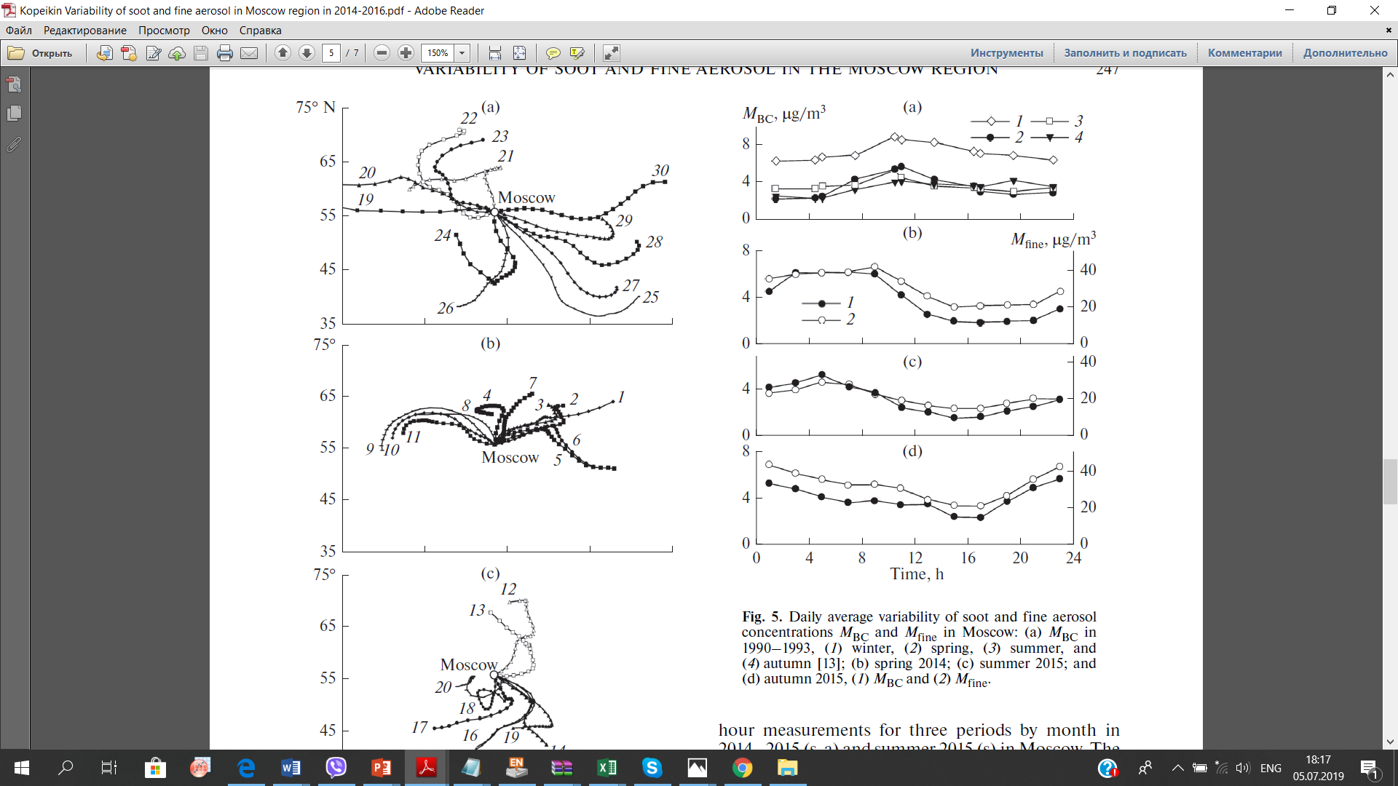
Diurnal BC variability in Moscow
METEOROLOGICAL OBSERVATORY MSU
MOSCOW CENTER, IAP
Our measurements Popovicheva et al, GES, 2019
Kopeikin et al. 2018
Apr May 2018,
Spring
summer
BC, µg/m3
autumn
Morning peak?

Slide 8
Diurnal variations of hourly BC concentrations, April – July 2019
Specific features in Moscow megacity:
morning maximum during months of heating system operating, its small level in other time
high nocturne BC
Notes:
Specific mechanism of BC diurnal emissions, fine particle formation, relation to Urban Heating I where Nocturne BC is high and stable in comparison with daytime.

Slide 9
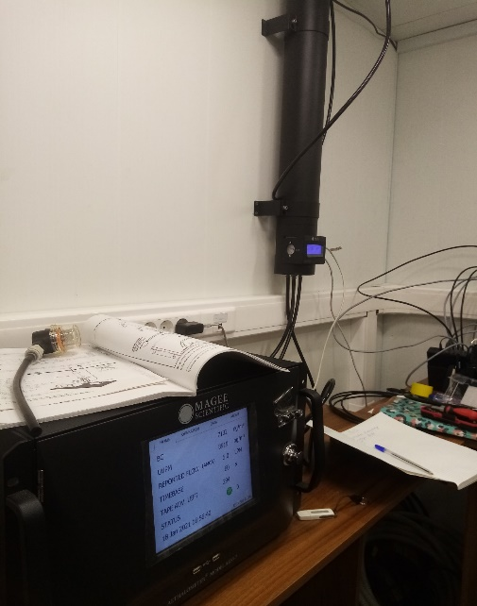
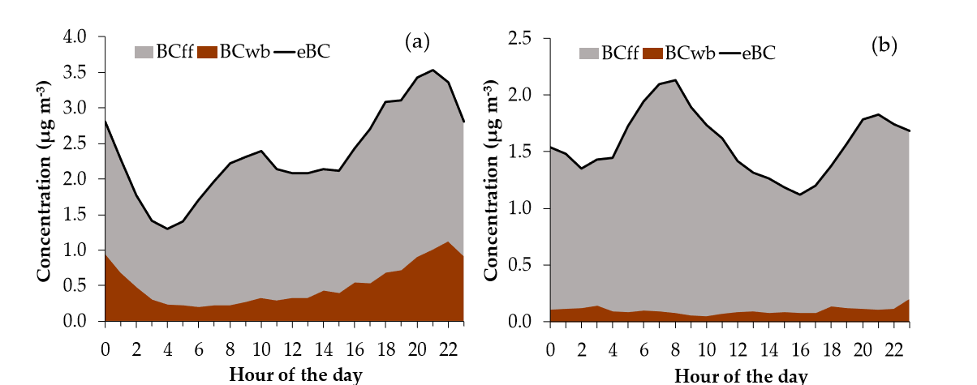
Continuous diurnal and season optical absorption measurements in the whole solar radiation range
of Black carbon and BC components:
BC ff - produced by fossil fuel combustion
BC bb - biomass burning
Two wavenumber aethalometer model: At first time the absorption coefficient at short wavenumbers will provide the assessment for the impact of biomass and waste burning in comparison with fossil fuel (gas, diesel, gasoline) combustion evaluated at long wavenumbers.
Objectives:
Observation of diurnal variability of BCff and BC bb in cold and warm seasons.
BC source apportionment for diurnal trend
Diapouli, AE, 2017, Athens megacity

Slide 10
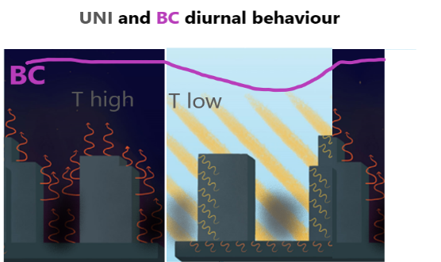
Analyses of phenomenon of stable high BC at night.
high BC nocturnal level ~ sources?
relation to UHI
Identification of sources for particular dynamics of
- stable high BC pollution at night time ,
including the season variability of urban activity and type of used fuel impacted the pollution accumulated in the atmosphere due to intensive emission of combustion sources.
Establishing the relation of stable high light-absorbing
aerosol pollution at night time to dynamics of
boundary layer and to temporal characteristics
of urban heat island

Slide 11
Continuous diurnal and season measurements of number size distribution and PM2.5 and PM10 mass
TSI Optical particle counter 3330, 300 nm – 10 µm

Slide 12
PM2.5 and PM10 mass
Intercalibration OPS & ТЕОМ aerosol number density in Moscow atmosphere ρ = 1.74±0.3 g/cm3
PM2.5

Slide 13
Project objectives: continuous measurements of particle number in a range of size distribution from ultrafine nanoparticles up to microparticles will allow to identify the formation of new particles and secondary aerosols in dependence on daytime and season.
TSI Optical particle counter 3330, 300 nm – 10 µm
below 300 nm to 5 nm
Nanoparticle spectrometer
Collaboration with University of Helsinki:
expansion of the range below 300 nm to 5 nm by installation of
a nanoparticle spectrometer compatible with OPC in the Aerosol Complex of Moscow State University
Suggestion for collaboration with University of Helsinki: collaboration work with expert in the field of nanoparticles who has
the experience in long-term measurements of ultrananoparticles. Content of works: selection of nanoparticle spectrometer model, installation, performance of measurement and data analysis.
Russian specialist visit to GAW/SMEAR station for transfer of nanoparticle measurement technology.

Slide 14
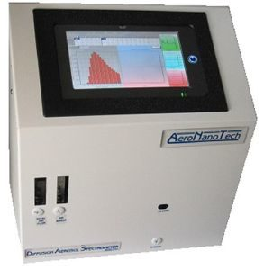
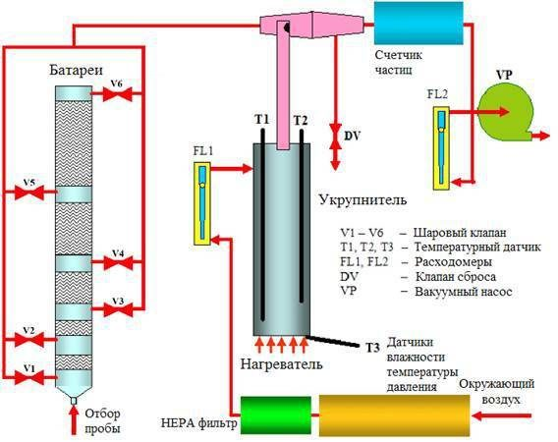
DIFFUSION AEROSOL SPECTROMETER
- monitor airborne particles within the
range from 5 to 10 000 nm.
It includes:
(i) a block of
diffusion batteries,
(ii) CPC module for growing the
particles passing through the diffusion batteries up to
optically distinguishable sizes
(iii) the laser aerosol
spectrometer, which counts the amplified particles
Size range: 5-10 000 nm
• Concentration limit: 100 000 particles per см3
• High resolution data: up to 409 channels
• Discreet particle measurement: works well for multi-mode samples
Independent of optical properties of the particles and fluid
• Easy setup with tool-less installation and auto discovery of components
• Use in a mobile version with an autonomous power source

Slide 15
II. Research. Aerosol chemistry
Quantifying the aerosol day-to-night pollution
based on measurements of
B) chemical PM10 composition (elements, ions, PAH).
Size- segregated chemical composition in the range from nano- to microparticles.

Slide 16
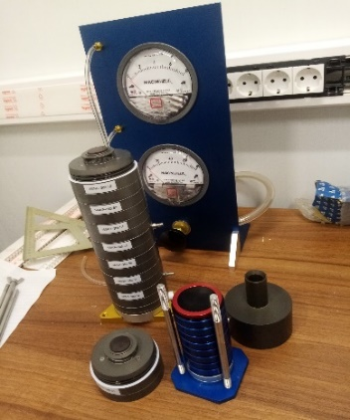
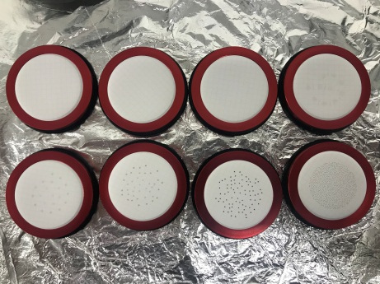
SAMPLING for
size - segregated chemical composition
- bulk composition of PM10
comprehensive in-situ 12h day and night sampling by Derenda PNS sampler and LVS sampler
size-fractionated particle composition in 180 nm to 10 µm
aerodynamic diameter range
by MOUDI impactor, 8 stages

Slide 17
CHEMICAL CHARACTERIZATION

Slide 18
Collaboration with University of Helsinki:
Characterization by analytic chemistry of element, water-soluble ions, and PAH concentrations
In order carrying out the analyses of chemical composition of sampled samples, collaboration work on analytical resources of University of Helsinki:
- transfer of experience and methods of sample analyses in the nanometer range on the MOUDI impactor,
- training in conducting the analytical work on ion chromatography and gas chromatography mass spectrometry by a student/graduate student of Moscow State University and performing the analyses of samples collected at the aerosol complex of Moscow State University during the project
Expected results: Assessment of daily and seasonal processes of evolution of atmospheric chemical composition, determined by the main sources of pollution in the urban environment.

Slide 19
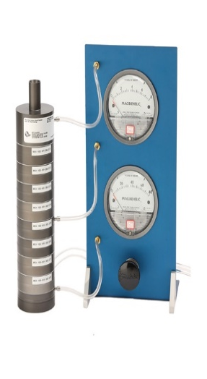

Aerosol Instrumentation Complex MSU- infrastructure developing
8 stages
Impactor
180 nm – 10 µm
DAS
5 nm – 10 µm
NAIS
Automatic
Sampler PNS
LVS
sampler
Optical particle counter
> 300 nm – 10 µm
Aethalometer AE33
Moudi 100NR

Slide 20
Expected results:
noticeable particularity of BC diurnal profiles and variability in Moscow megacity.
dominant optical absorption by BCff due to transport/industry emission vs BC bb
impact of season on BC diurnal and spatial variability and level of pollution BC/PM2.5.
identification of mechanism of interaction between of stable nocturne BC to UHI intensity at night.

Slide 21
Aerosol Instrumentation Complex MSU- infrastructure
for measurements of optical and physico-chemical properties of ambient aerosols
8 stages
Impactor
180 nm – 10 µm
Automatic
Sampler PNS
LVS
sampler
Optical particle counter
> 300 nm – 10 µm
Aethalometer AE33
Moudi 100NR

